Slide 1



Fake News Detection and Analysis System for Online News and Social Media
Group 1
Member Name | Matric No.
Sun Yuchen | A0326248B
Zhang Yuxuan | A0285664N
Zhao Jiahui | A0329852U

Slide 2
1. Project Objectives
2. Project Scope
3. Data Available
4. Technical Approaches
5. Conclusion

Slide 3

Project
Objectives
Project
Scopes
Data
Available
Technical
Approaches
Final
Conclusion
Background
Objectives
With the rapid growth of social media and online news platforms, information spreads faster than ever. This has led to widespread dissemination of fake news, which misleads the public, influences political opinions, and damages the credibility of legitimate media sources.
For media companies, government agencies, and online platforms, manually verifying news authenticity is time-consuming and inefficient. There is a strong need for automated NLP-based systems that can analyze textual content and identify potentially false or misleading information.
The goal is to develop a Fake News Detection and Analysis System that automatically analyzes news articles and determines whether they are likely to be fake or real.
The system aims to:
Automatically classify news as fake or real (BERT)
Identify article topic / category (LDA / BERTopic)
Analyze sentiment: positive, negative, or neutral
Present results through a Streamlit web interface
Such a system supports decision-making by enabling users to quickly evaluate the credibility of information circulating online.

Slide 4
Project
Objectives
Project
Scopes
Data
Available
Technical
Approaches
Final
Conclusion
Background
Objectives
With the rapid growth of social media and online news platforms, information spreads faster than ever. This has led to widespread dissemination of fake news, which misleads the public, influences political opinions, and damages the credibility of legitimate media sources.
For media companies, government agencies, and online platforms, manually verifying news authenticity is time-consuming and inefficient. There is a strong need for automated NLP-based systems that can analyze textual content and identify potentially false or misleading information.
The goal is to develop a Fake News Detection and Analysis System that automatically analyzes news articles and determines whether they are likely to be fake or real.
The system aims to:
Automatically classify news as fake or real (BERT)
Identify article topic / category (LDA / BERTopic)
Analyze sentiment: positive, negative, or neutral
Present results through a Streamlit web interface
Such a system supports decision-making by enabling users to quickly evaluate the credibility of information circulating online.

Slide 5
Project
Objectives
Project
Scopes
Data
Available
Technical
Approaches
Final
Conclusion
This project develops an NLP-based fake news detection system using a hybrid dataset. The scope includes data collection, preprocessing, model training, and system integration:
Fake News Classification Module:
Fine-tune BERT to classify news articles as fake or real. Output includes confidence scores. Baseline comparison with TF-IDF + Logistic Regression / SVM.
Topic Classification Module:
Identify the main topic / category of articles (politics, health, technology, business) using LDA or BERTopic as supporting analytical signals.
Sentiment Analysis Module:
Analyze news content sentiment using pre-trained models to determine positive, negative, or neutral tone — enriching user interpretation of results.
Evaluation & System Integration:
Evaluate with accuracy, precision, recall, F1-score, confusion matrix and qualitative error analysis. Integrate all modules into a Streamlit demo interface.
Scope is limited to text-based detection on the Kaggle dataset + self-collected Snopes/PolitiFact samples. Out of scope: real-time monitoring, multimedia detection, cloud deployment.

Slide 6
Project
Objectives
Project
Scopes
Data
Available
Technical
Approaches
Final
Conclusion
Kaggle Fake News Dataset
Kaggle Fake News Dataset
Total Articles:
20,000+
The Kaggle Fake News Dataset serves as the primary training source, providing over 20,000 labeled articles (fake/real) with title and text fields. Its scale and balanced class distribution make it suitable for fine-tuning BERT.
To reduce dataset bias, 200–500 additional articles are self-collected from Snopes and PolitiFact (bonus points: self-collected data). Labels are aligned with fact-check verdicts and cross-validated by ≥2 team members. Near-identical articles are deduplicated; self-collected samples do not overlap with the test set.
Combined benefits: sufficient labeled volume for deep learning, diversity for generalization, and realistic evaluation.
Classes:
Fake / Real
Fields:
Title, Text, Label
Data Split:
80 / 10 / 10 %
Self-Collected Samples
Sources:
Snopes, PolitiFact
Volume:
200–500 articles
Labeling:
Fact-check verdicts
Validation:
≥2 team members

Slide 7
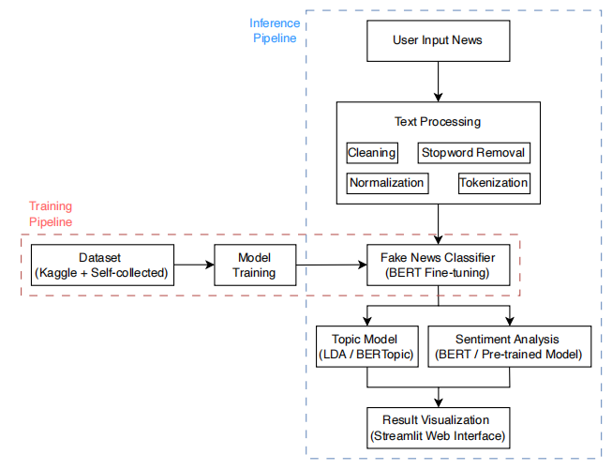
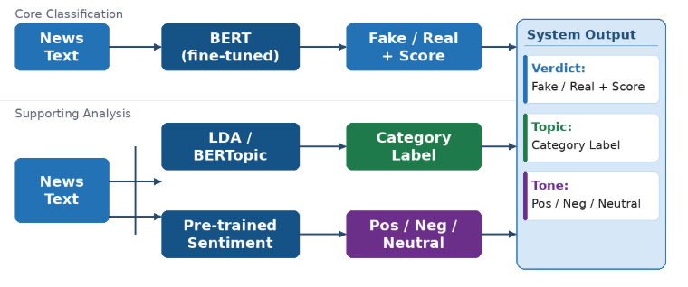
Project
Objectives
Project
Scopes
Data
Available
Technical
Approaches
Final
Conclusion
Core Components
• Fake News Classification (BERT)
• Topic Modeling (LDA / BERTopic)
• Sentiment Analysis
• Streamlit interface for visualization

Slide 8
Project
Objectives
Project
Scopes
Data
Available
Technical
Approaches
Final
Conclusion
Effort Estimates
Task
Effort
Key Activities
Dataset Preparation
& Cleaning
20%
Download Kaggle data; scrape Snopes / PolitiFact;
clean, tokenize, normalize, deduplicate
Fake News Model
Development
30%
Fine-tune BERT; optimize pipeline; baseline SVM/LR;
hyperparameter tuning
Topic & Sentiment
Modules
15%
Implement LDA / BERTopic; integrate pre-trained
sentiment model; validate outputs
System Integration
& Demo Interface
15%
Combine all modules; build Streamlit UI;
visualize confidence & supporting signals
Evaluation & Error
Analysis
10%
Measure F1, accuracy, confusion matrix;
qualitative analysis on satire / ambiguous cases

Slide 9
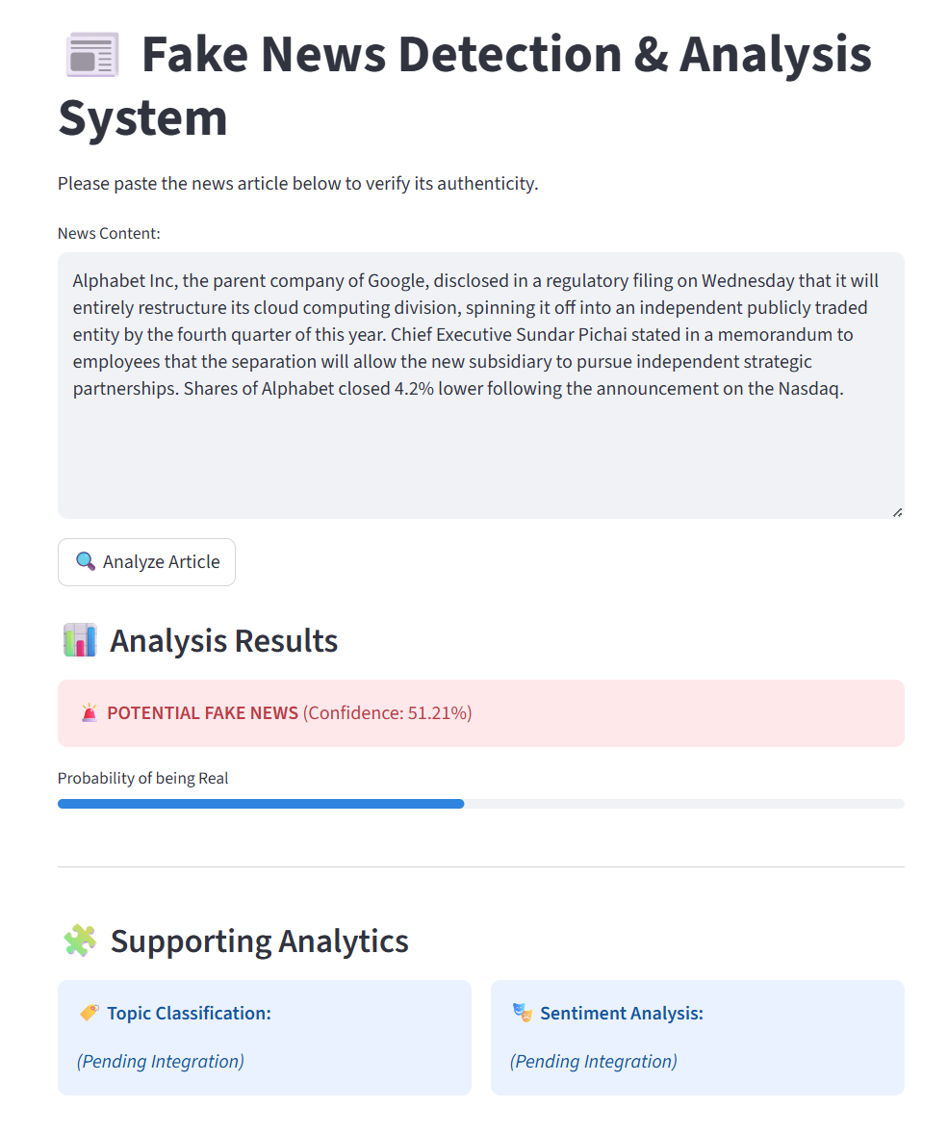
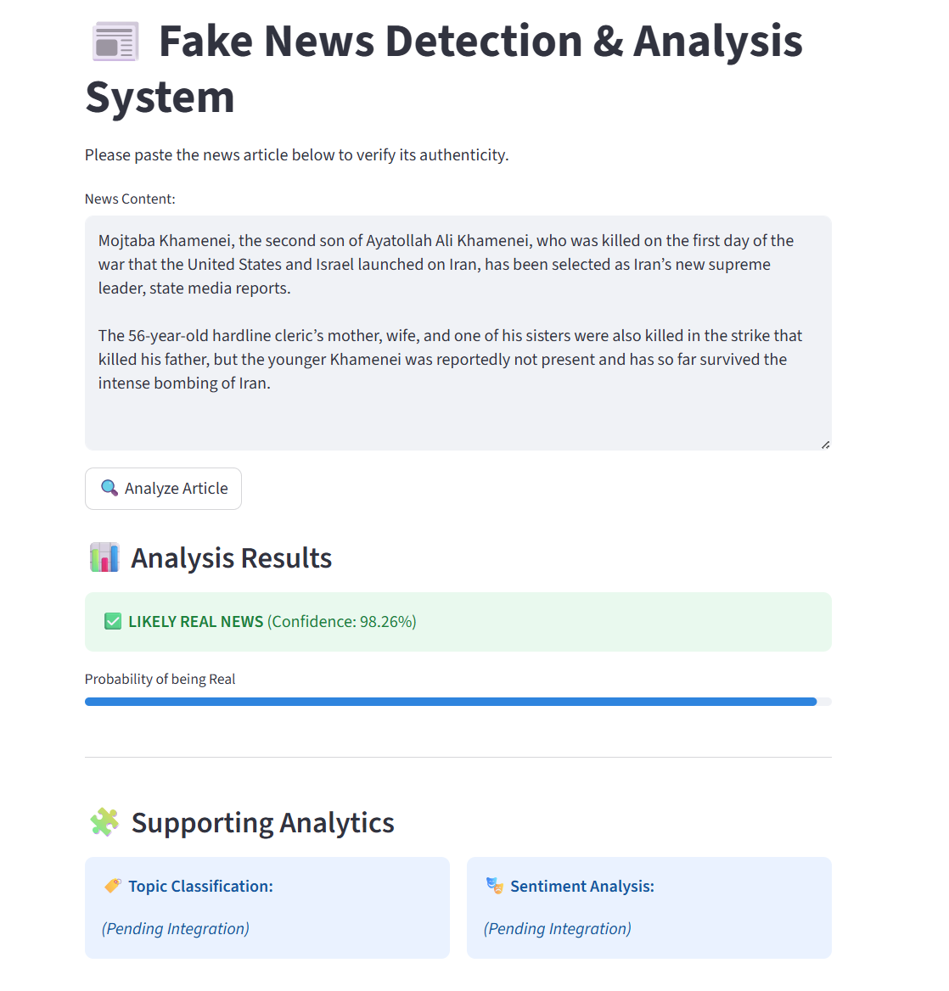
Project
Objectives
Project
Scopes
Data
Available
Technical
Approaches
Final
Conclusion
Expected Outcome

Slide 10
Project
Objectives
Project
Scopes
Data
Available
Technical
Approaches
Final
Conclusion
This project proposes a practical NLP-based fake news detection system combining BERT-based classification, topic modeling (LDA/BERTopic), and sentiment analysis. The BERT classifier is the core detection engine; topic and sentiment signals provide contextual enrichment to help users interpret predictions.
A hybrid dataset strategy — Kaggle benchmark (20,000+ articles) supplemented by self-collected fact-checked samples from Snopes and PolitiFact — ensures training quality, diversity, and realistic evaluation. Performance is assessed by F1-score, precision, recall, accuracy, and qualitative error analysis on edge cases (satire, ambiguous language).

Slide 11
Q & A

Slide 12
Thank you!

